Slide 1
SUPERVISED LEARNING METHODS

Slide 2
RECAP = Supervised Learning Algorithms
All classification and regression algorithms come under supervised learning.
Logistics Regression
Decision Trees
Support Vector Machine (SVM)
K- Nearest Neighbors
Naïve Bayes
Random Forest
Linear Regression
Polynomial Regression
SVM for Regression

Slide 3

ML Steps

Slide 4
REGRESSION

Slide 5
LINEAR REGRESSION

Slide 6
Scenario
You are a sales manager of an umbrella company trying to predict next month’s numbers.
You know several factors can affect the sales
  Weather
  Competition’s promotion
  Rumor of a new and improved model
People in your organization even have a theory about what will have the biggest effect on sales. “Trust me. The more rain we have, the more we sell.” “Six weeks after the competitor’s promotion, sales jump.”
Regression analysis is a way of mathematically sorting out which of those variables does indeed have an impact. It answers the questions: Which factors matter most? Which can we ignore? How do those factors interact with each other? And, perhaps most importantly, how certain are we about all of these factors?

Slide 7
Regression questions
Regression analysis is a way of mathematically sorting out which of those variables does indeed have an impact. It answers the questions: Which factors matter most? Which can we ignore? How do those factors interact with each other? And, perhaps most importantly, how certain are we about all of these factors?
In regression analysis, those factors are called variables. You have your dependent variable — the main factor that you’re trying to understand or predict. In Redman’s example above, the dependent variable is monthly sales. And then you have your independent variables — the factors you suspect have an impact on your dependent variable.

Slide 8
How does it work?
In order to conduct a regression analysis, you gather the data on the variables in question.
You take all of your monthly sales numbers for, say, the past three years and any data on the independent variables you’re interested in.
So, in this case, let’s say you find out the average monthly rainfall for the past three years as well. Then you plot all of that information on a chart
Is there a relationship between these two variables? Y is the sales numbers, and x is the amount of rain

Slide 9
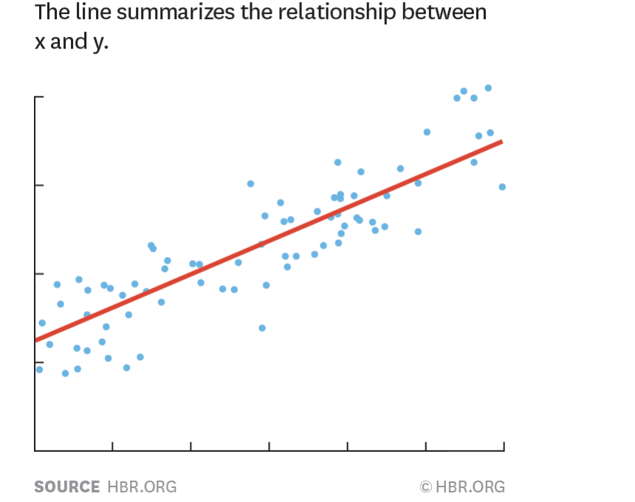
Building a regression model
The redline is called regression line

Slide 10
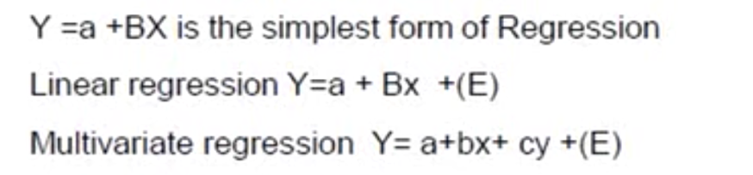
Regression Modeling
Regression modeling involves, dependent variable, independent variable and unknown parameters

Slide 11
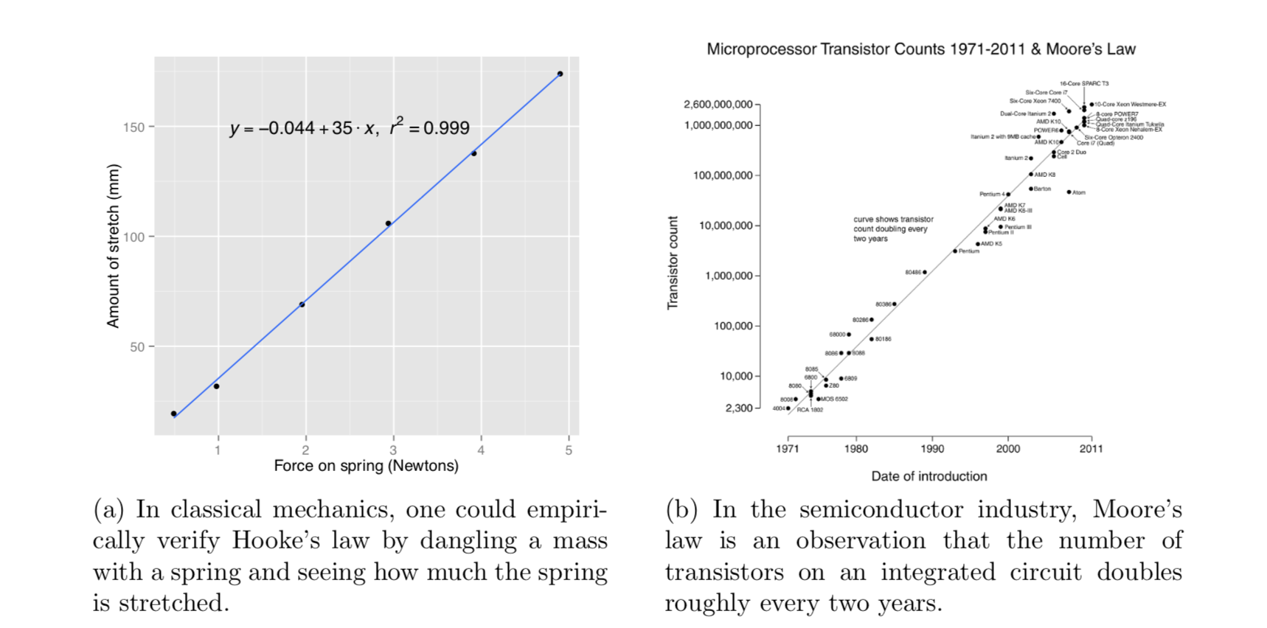
Linear Regression

Slide 12
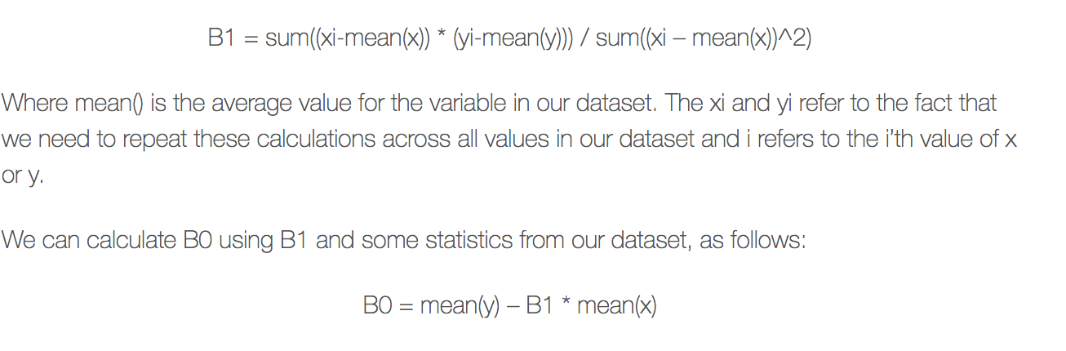
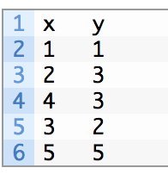
Linear Regression
y= B0 + B1 x
x – independent variable or predictor variable
y – dependent variable
B1 – slope of the line
B0 - intercept

Slide 13
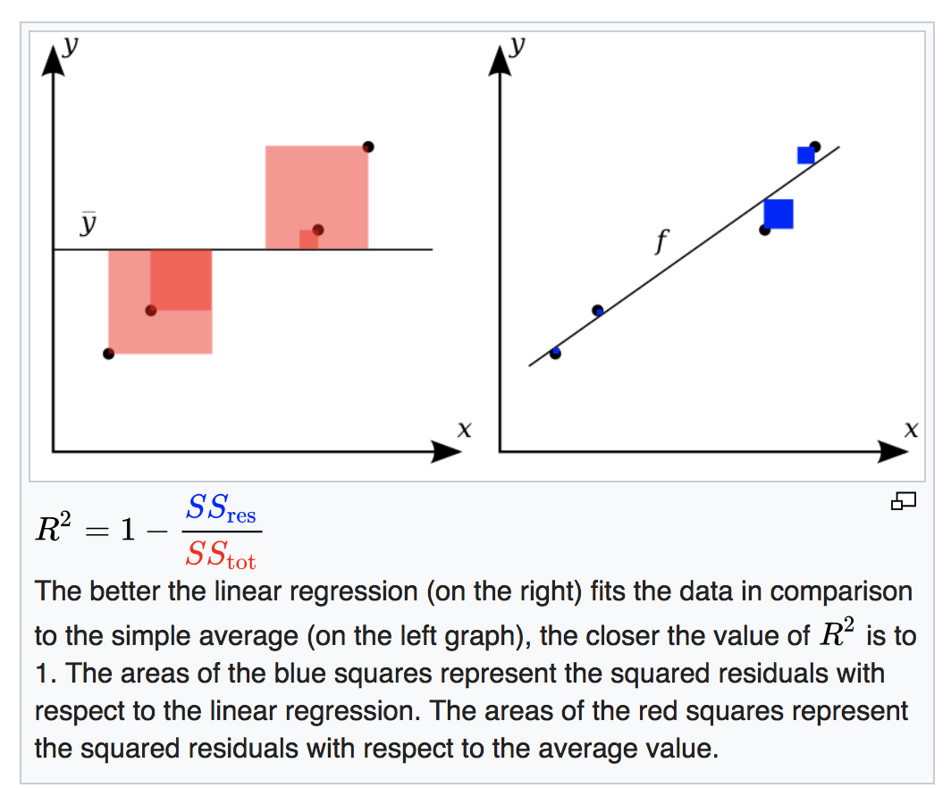
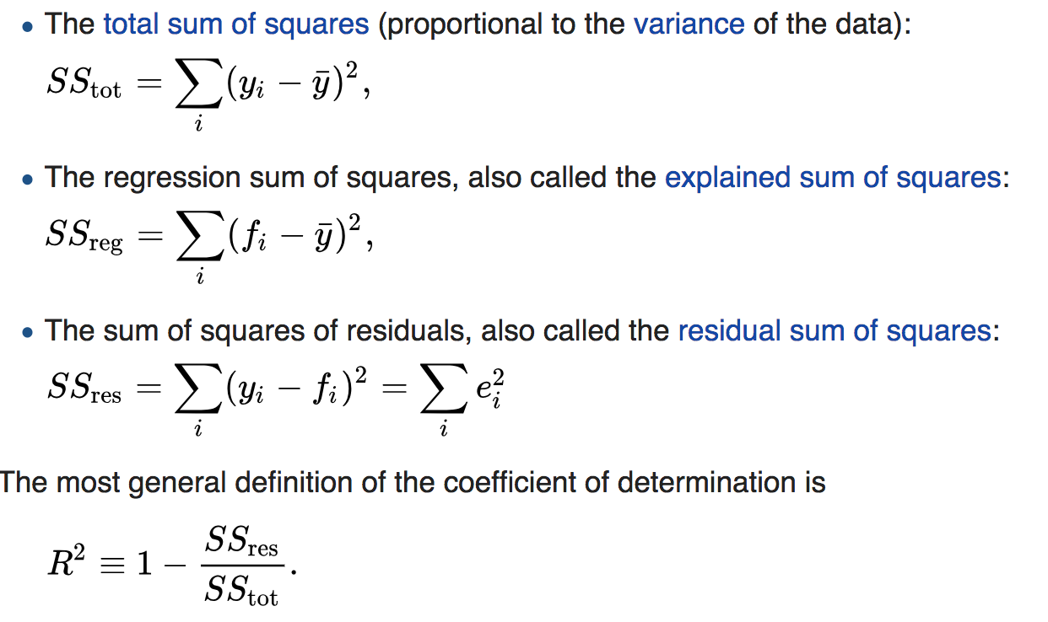
Coefficients of determination
The coefficient of determination, denoted R² or r² , is the proportion of the variance in the dependent variable that is predictable from the independent variable(s).

Slide 14
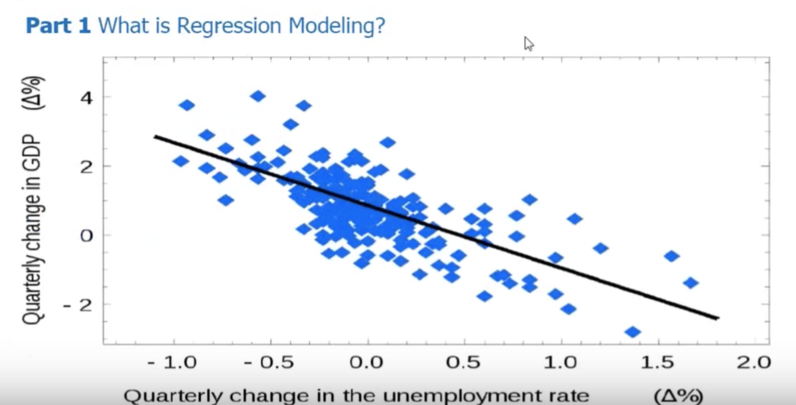
Example

Slide 15
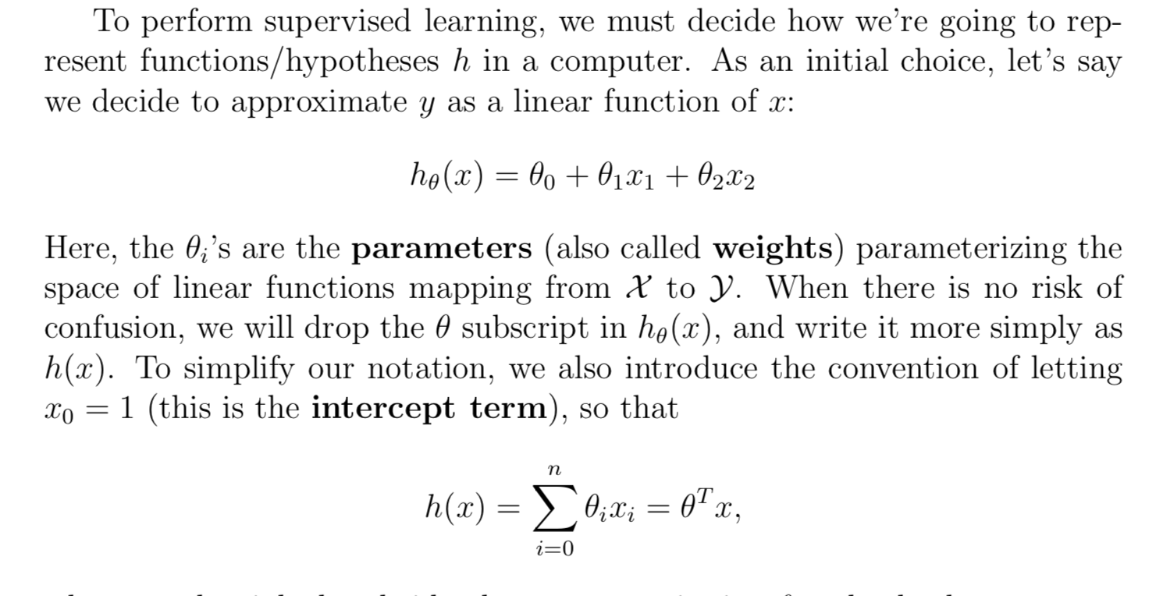

Slide 16
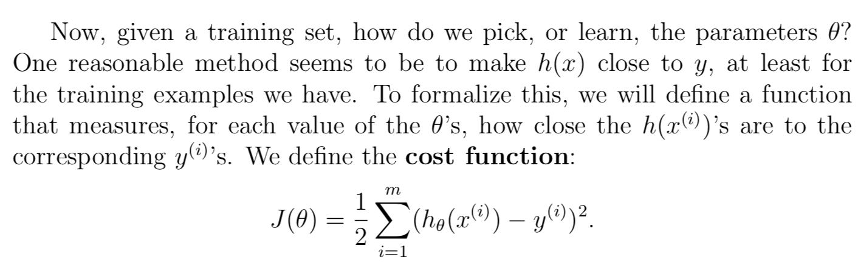

Slide 17
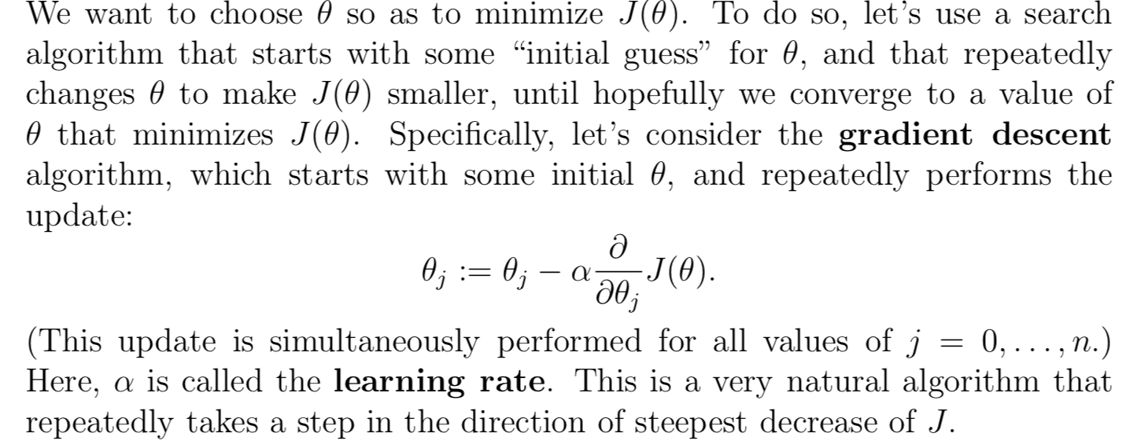
Least Mean Squared Algorithm

Slide 18
Correlation is not ‘causation’
Assume that the salesman was trying was selling apples, not umbrellas
Does the increase in sales w.r.t increase in rains make sense?
Correlation is not causation. This is critical and here’s why: It’s easy to say that there is a correlation between rain and monthly sales of apples. The regression shows that they are indeed related. But it’s an entirely different thing to say that rain caused the sales of apples. Unless in the case of umbrellas, it might be difficult to prove that there is cause and effect.
When you see a correlation from a regression analysis, you can’t make assumptions,
“You have to go out and see what’s happening in the real world. What’s the physical mechanism that’s causing the relationship?”
Go out an observe consumers buying your product in the rain, talk to them, and find out, what is actually causing them to make the purchase. “A lot of people skip this step and I think it’s because they’re lazy. The goal is not to figure out what is going on in the data but to figure out is what is going on in the world. You have to go out and pound the pavement,” he says.
Redman wrote about his own experiment and analysis in trying to lose weight and the connection between his travel and weight gain. He noticed that when he traveled, he ate more and exercised less. So was his weight gain caused by travel? Not necessarily. “It was nice to quantify what was happening but travel isn’t the cause. It may be related,” he says, but it’s not like his being on the road put those extra pounds on. He had to understand more about what was happening during his trips. “I’m often in new environments so maybe I’m eating more because I’m nervous?” He needed to look more closely at the correlation. And this is his advice to managers. Use the data to guide more experiments, not to make conclusions about cause and effect. (source HBR)

Slide 19
Head - Brain Analysis
Download Head_Brain Data from GitHub
1. Draw a scatter plot
2. Do linear regression from scratch
3. List the coefficients
4. Calculate RMSE [Root mean squared error]
5. Calculate R²

Slide 20
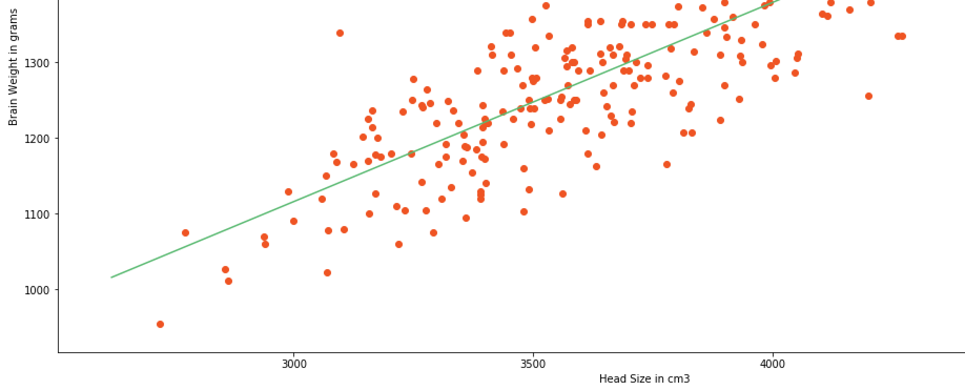

Slide 21
